Slide 1
Using AI Agents to Create AI Agents
Impacts on Education
In 10 Minutes
Dan McCreary

Slide 2
Positive Feedback Loop
AI Agent
Used to Create

Slide 3
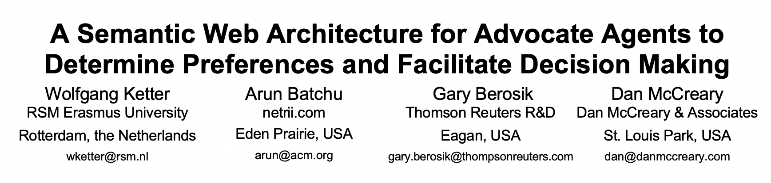
Background for Dan McCreary
2008 paper on agents used RDF in the browser
Ran as a Firefox plugin and helped you shop
Based on simple rules

Slide 4
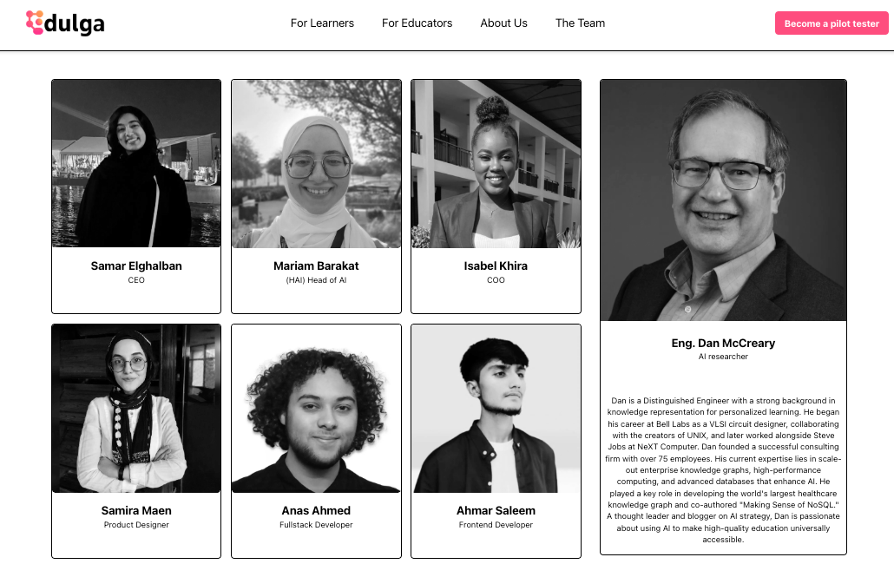
https://www.edulga.ai/team

Slide 5
Agents: 0 to $2.5B in 18 Years
Dan published first agent paper in 2008
Started using GPT-3 in 2021 to generate lesson plans for teachers
Prompts were very long and contained many examples
As LLMs got bigger, prompts got smaller
LLMs began to be easier to use and generated consistent Markdown
In 2022, we began to use GPT to write code - 10 lines at most
Nov 30, 2022 - ChatGPT introduced by OpenAI
In July 2023, Val Lockhart coined the term "MicroSim."
2023 Cursor IDE launched
January 2025 Anysphere Cursor valued at $2.5 billion
¼ of Y-Combinator startups had over 95% of their code written by AI
Most new agents and MCPs are being written by agents

Slide 6
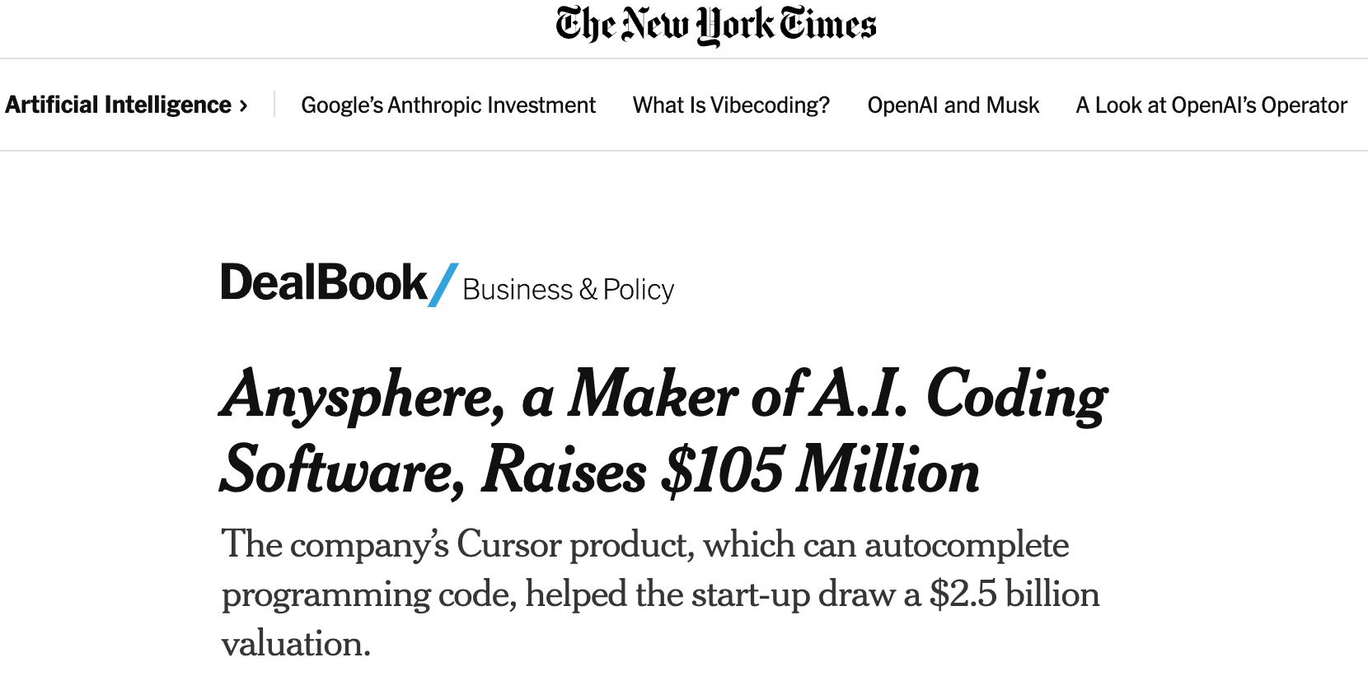
1/14/2005
https://www.nytimes.com/2025/01/14/business/dealbook/anysphere-cursor-25-billion-valuation.html

Slide 7
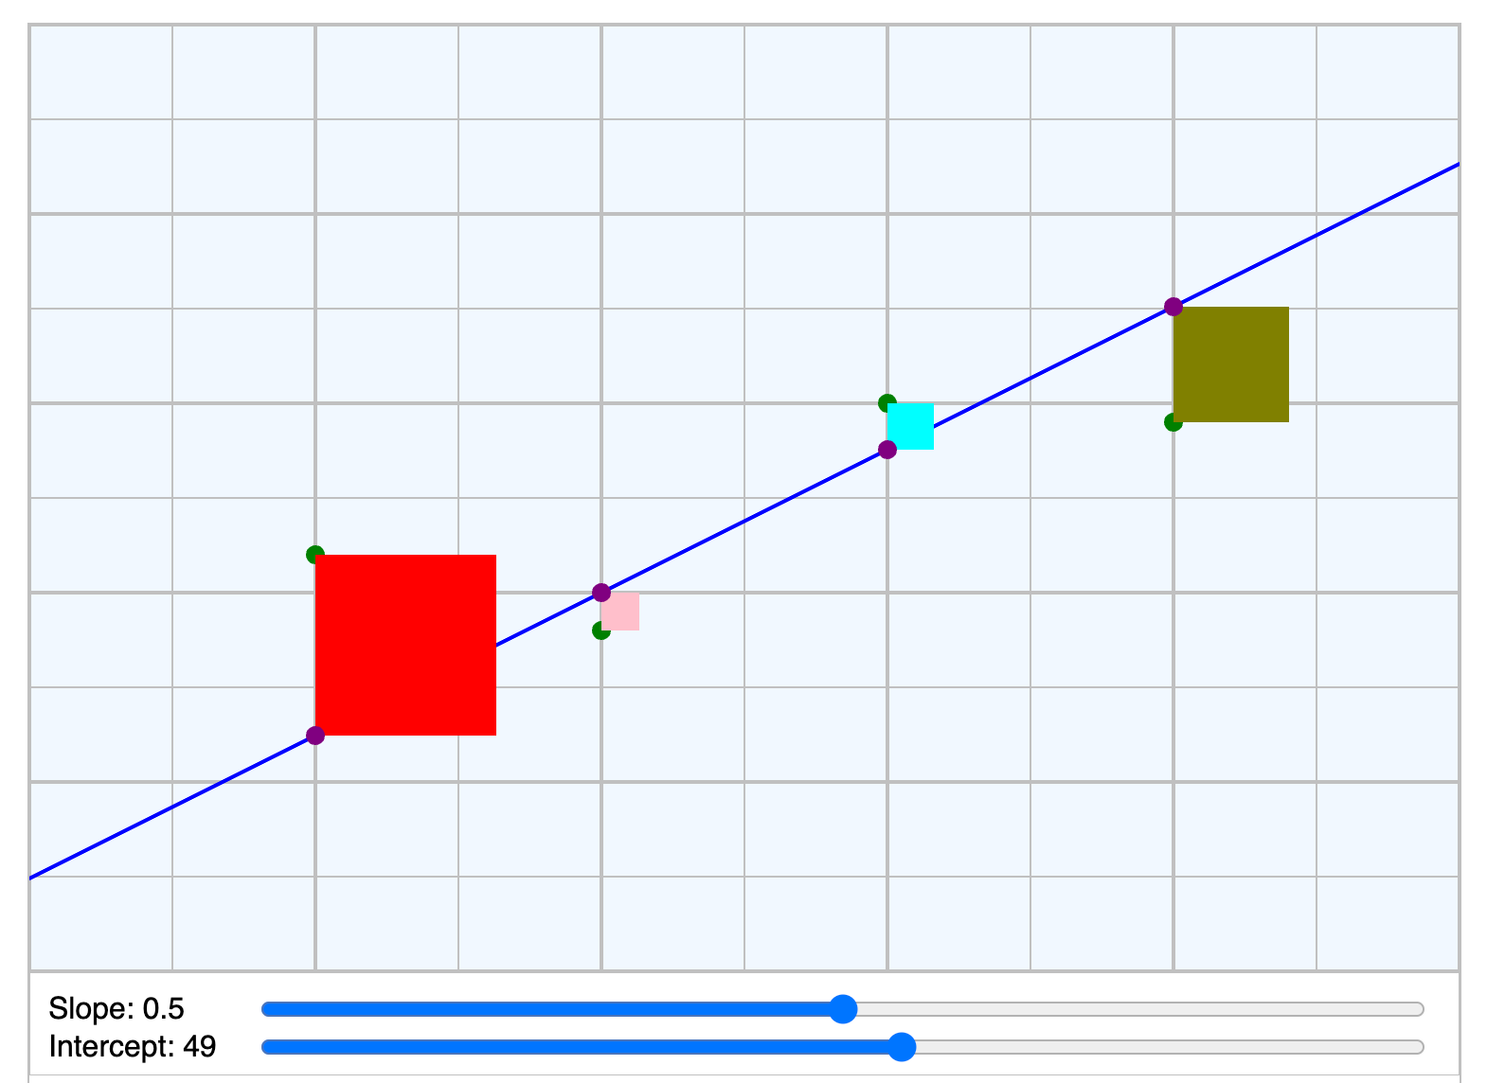
Least Squares
https://dmccreary.github.io/microsims/sims/least-squares/

Slide 8
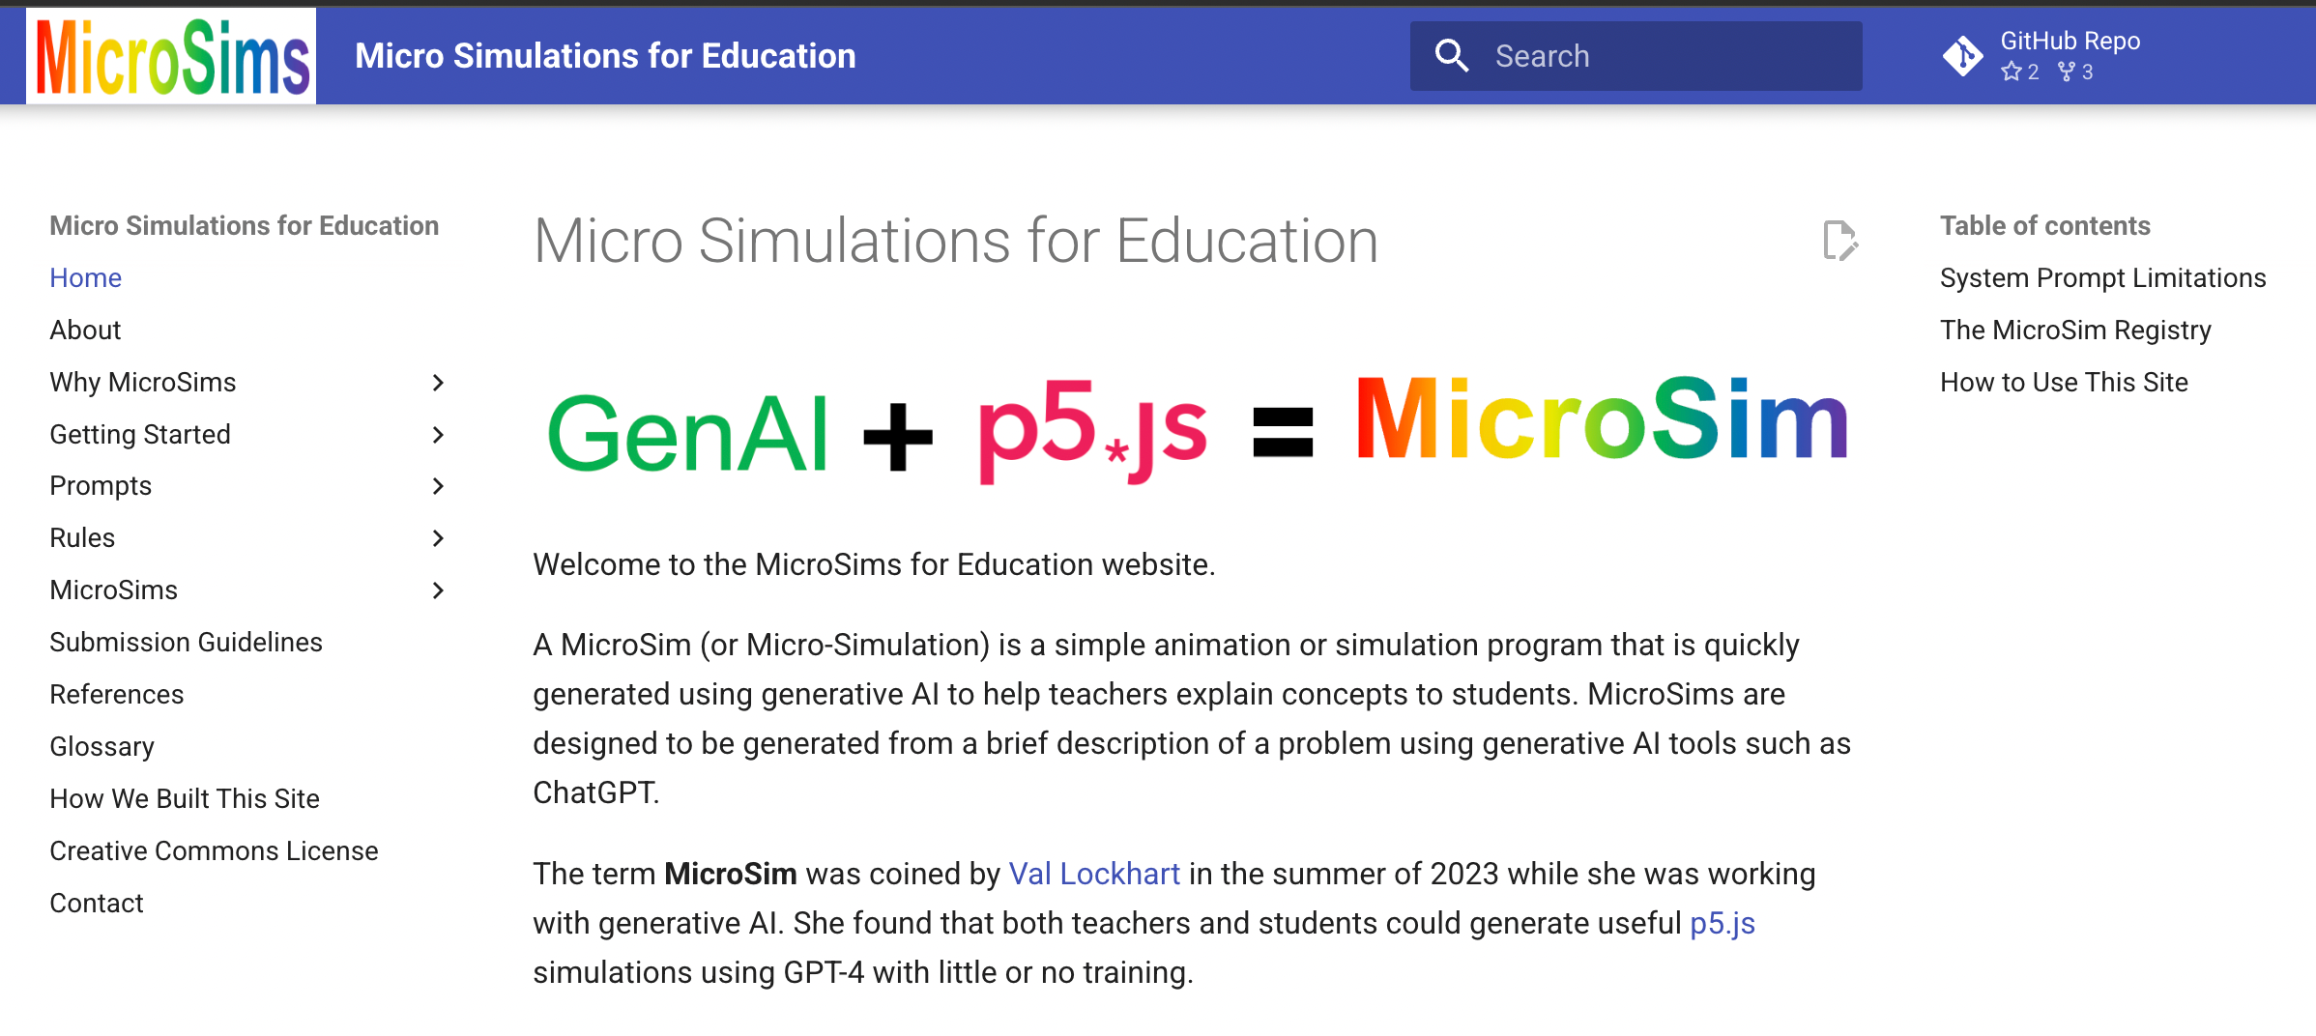
https://dmccreary.github.io/microsims/

Slide 9
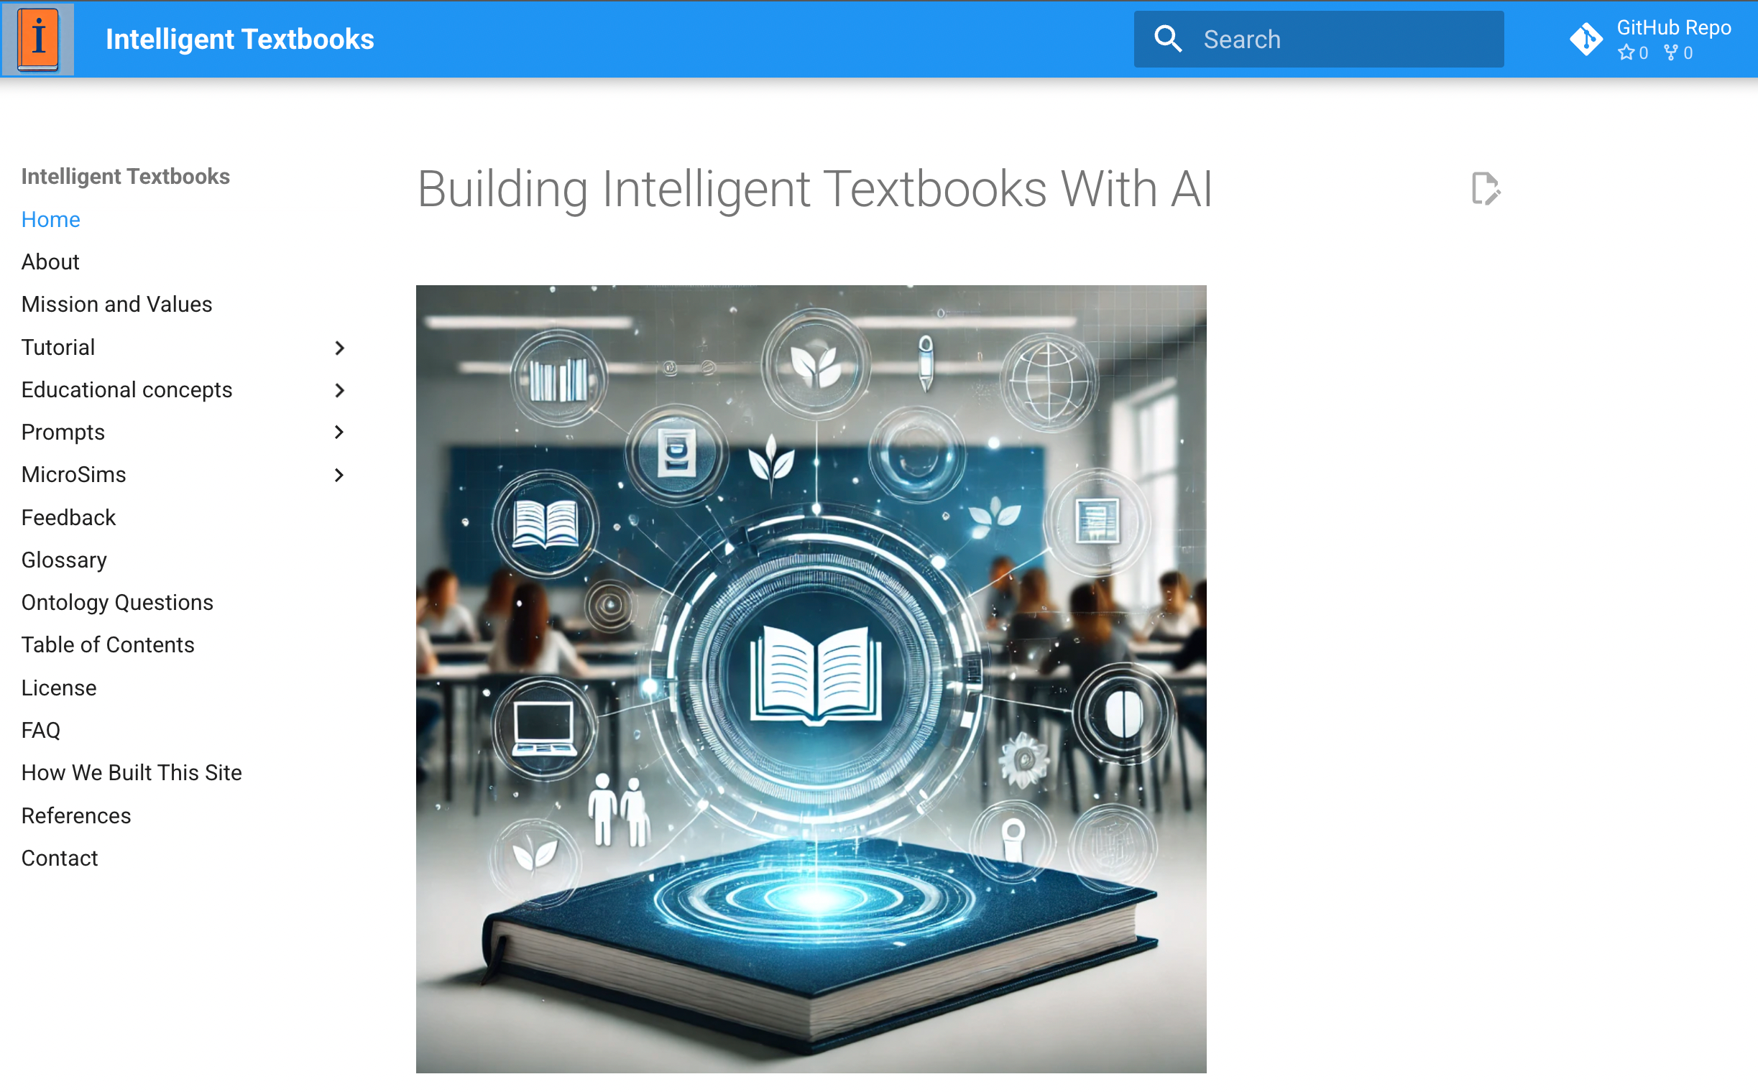
https://dmccreary.github.io/intelligent-textbooks/

Slide 10
Knowledge Representation
“The key to artificial intelligence has always been the representation.”
Jeff Hawkins

Slide 11
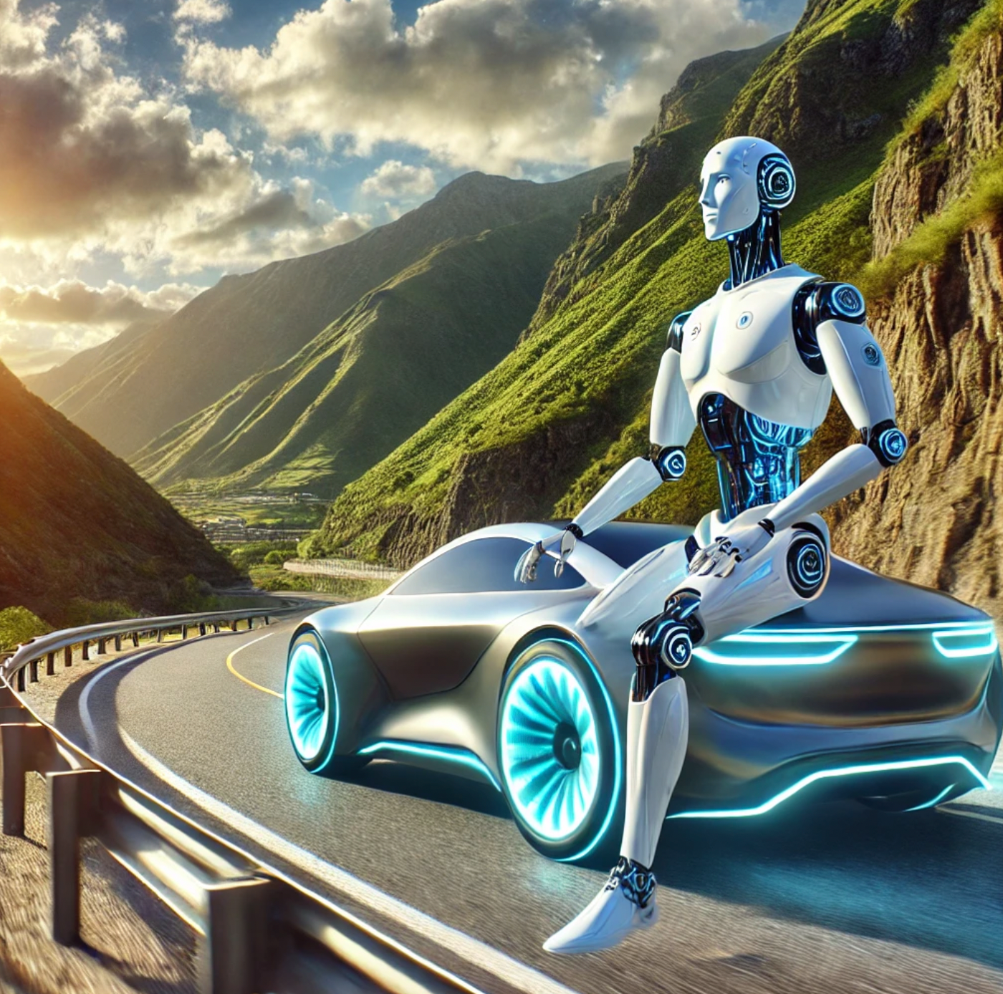
Agent Guardrails

Slide 12
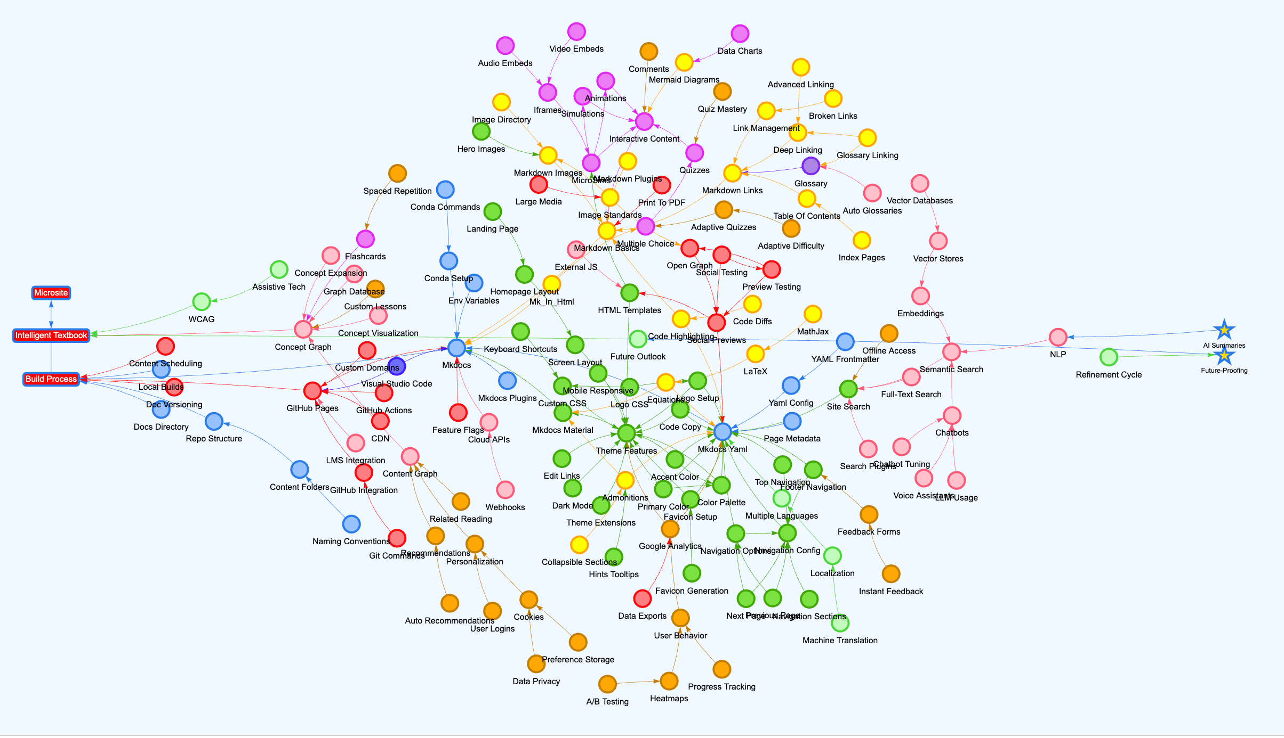
Learning Graph for Intelligent Textbooks
https://dmccreary.github.io/intelligent-textbooks/sims/learning-graph/graph-viewer.html

Slide 13
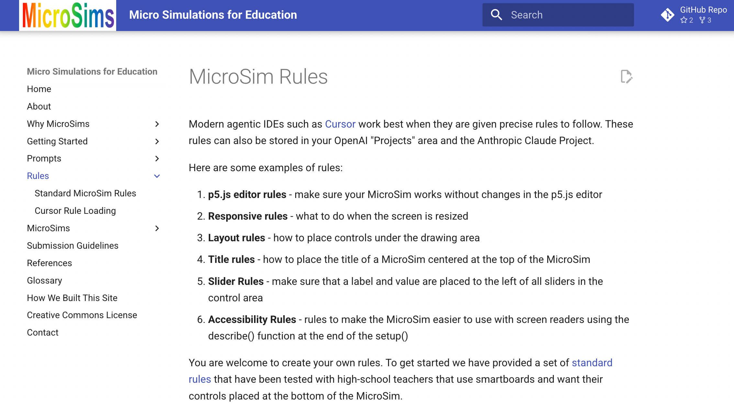
IDE Agent Generation Rules
https://dmccreary.github.io/microsims/rules/

Slide 14
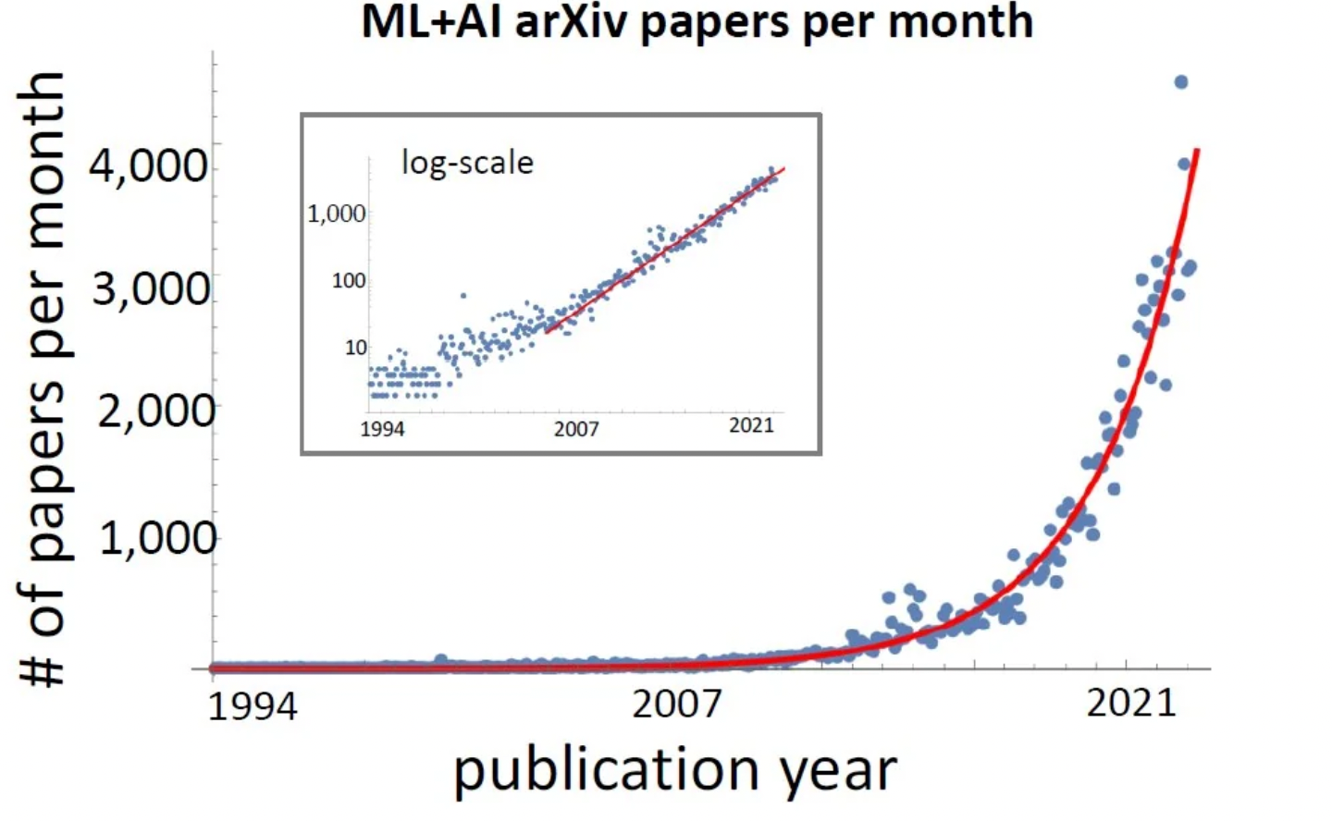
Rate of Change is Getting Faster
Doubling every 24 months
https://www.reddit.com/r/singularity/comments/xwdzr5/the_number_of_ai_papers_on_arxiv_per_month_grows/

Slide 15
Sample Intelligent Textbooks
Agents Course: https://dmccreary.github.io/agents-course/
Deep Learning Course: https://dmccreary.github.io/deep-learning-course/
Intelligent Textbooks: https://dmccreary.github.io/intelligent-textbooks/
MicroSims: https://dmccreary.github.io/microsims/
Learning Graphs: https://dmccreary.github.io/learning-graphs/
MicroPython: https://dmccreary.github.io/learning-micropython/
Clocks and Watches: https://dmccreary.github.io/clocks-and-watches/
Graph Algorithms: https://dmccreary.github.io/graph-algorithms/
Signal Processing: https://dmccreary.github.io/signal-processing/
Circuits: https://dmccreary.github.io/circuits/
Maroon text developed with the help of the University of Minnesota

